Slide 1
SSH Jump Server
Group 13
B07902066 黃禹喆 B07902062 張彧瑋 B07902068 陳柏豪 B07902080 黃義峰

Slide 2
Environment
Jump server OS: CentOS7
Language: Python(ssh-forward-proxy server), shell script(client), javascript+css+html(monitor)

Slide 3





System Structure
Monitoring
Workstations
Our server
Redirect connection A
User A’s host
Display
Redirect connection B
User B’s host

Slide 4
SSH Proxy Server Implementation
Jump server opens a socket listening on port 4000.
Client connects to port 4000 on jump server. Then the jump server will accept the client’s connection, and open another thread to interact with the client.
The thread decides the optimal workstation serverto redirect the connection to according to the filter rule that is passed down, build another ssh flow between the proxy server and the workstation server.
The server continues to support the connection as a proxy until the client stops the connection.
Reference: https://github.com/lincheney/ssh-forward-proxy

Slide 5
Monitor Implementation
1.Backend: Open servers on each workstation. Servers listen on port 7474, and send out the devices’ status back to the jump server when the jump server requests.
2.Frontend: Send request to the workstation devices, and update the current status.

Slide 6
Functions
1. Create a jump server as an gateway of workstations.
2. The jump server should monitor loading of workstations(ex. CPU usage) and redirect connection requests according to workstation load.
3. Display the result of monitoring and redirecting on an administration page.

Slide 7
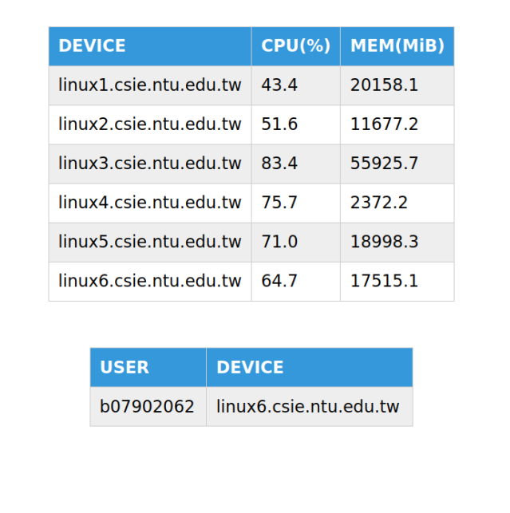
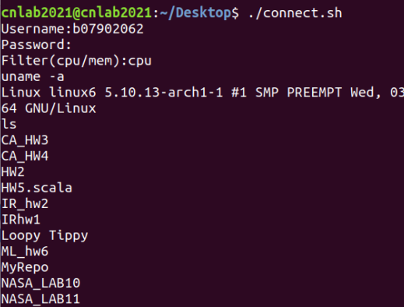
Final Result

Slide 8
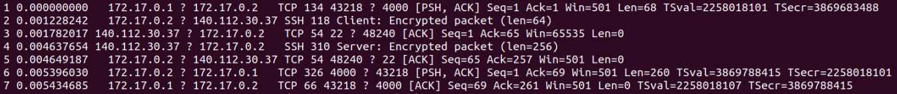
Final Result
tshark Result on SSH Proxy Server
172.17.0.1: Client 172.17.0.2: SSH Proxy Server
140.112.30.37: Workstation

Slide 9
Client
ACK
command
Command
result
ACK
Proxy Server
ACK
ACK
command
Command
result
Workstation

Slide 10
Demonstration

Slide 11
Q&A
Thank you for listening!

